Slide 1

Lecture 7: Basics of JavaScript
Open Source Web Software

Slide 2
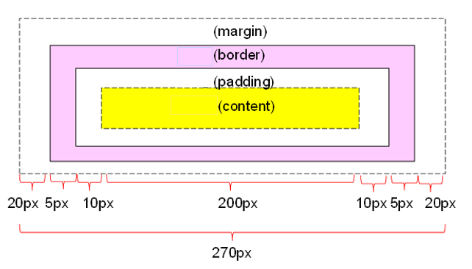
In Last Lecture
CSS Box Model
CSS Box Model consists of the followings:
margins, borders, padding, and the actual content
Width and height of an Element
How to calculate box size

Slide 3
In Last Lecture
CSS Display
display: block
display: inline
display: none
visibility: hidden
display: inline-block
The position property specifies the type of positioning method used for an element
Static positioning
Relative positioning
Absolute positioning
Fixed positioning

Slide 4
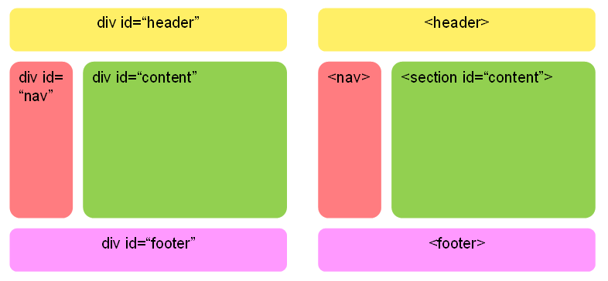
In Last Lecture
CSS Layout

Slide 5
Table of Contents
Part 1.
What is JavaScript?
Part 2.
JavaScript Basic Syntax
Part 3
JavaScript Practice

Slide 6
What is javascript?
Part 1

Slide 7
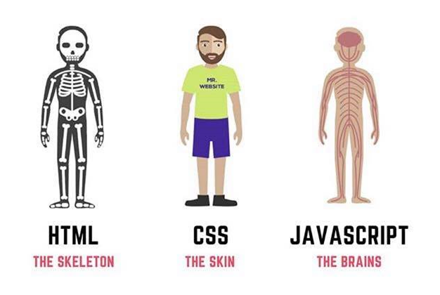
What is JavaScript?
JavaScript is the programming language of the Web

Slide 8
What is JavaScript?
Features of JavaScript
Interpreted language
Dynamic typing
Functional programming (like C Language)
Object oriented programming (like C++ or Java)
JavaScript is a scripting language and it is not Java
It is easy to learn

Slide 9
What is JavaScript?
Location of JavaScript
External JavaScript
Inner JavaScript
Inline JavaScript

Slide 10
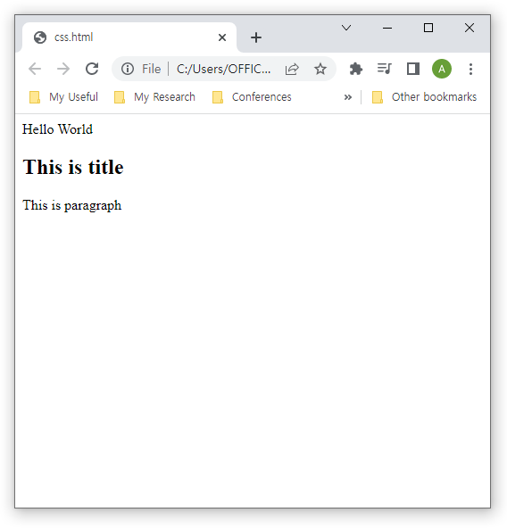
What is JavaScript?
External JavaScript
Located as separate file with .js extension
<!DOCTYPE html>
<html>
<head>
<script src="myscript.js"></script>
</head>
<body>
<h2>This is title</h2>
<p>This is paragraph</p>
</body>
</html>
myscript.js
document.write("Hello World")

Slide 11
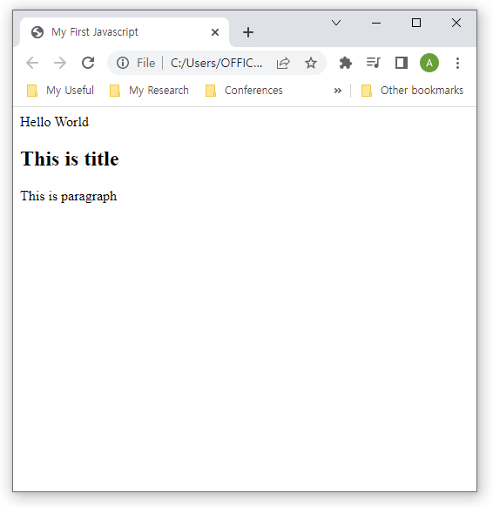
What is JavaScript?
Inner JavaScript
Located in header of HTML document between <script> and </script>
<!DOCTYPE HTML>
<html>
<head>
<title>My First Javascript</title>
<script>
document.write("Hello World")
</script>
</head>
<body>
<h2>This is title</h2>
<p>This is paragraph</p>
</body>
</html>

Slide 12
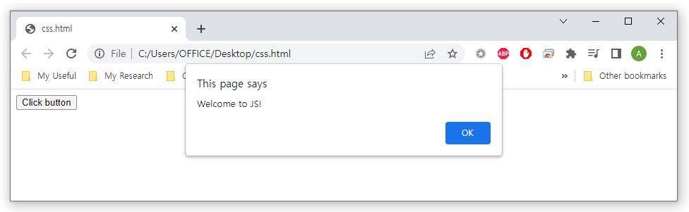
What is JavaScript?
Inline JavaScript
Located inside of HTML element
<!DOCTYPE html>
<html>
<body>
<button type="button" onclick ="alert('Welcome to JS!')">Click button</button>
</body>
</html>

Slide 13
Javascript syntax
Part 2

Slide 14
JavaScript Syntax
JavaScript Output
JavaScript can "display" data in different ways
Writing into an HTML element, using innerHTML
Writing into the HTML output using document.write()
Writing into an alert box, using window.alert()
Writing into the browser console, using console.log()

Slide 15
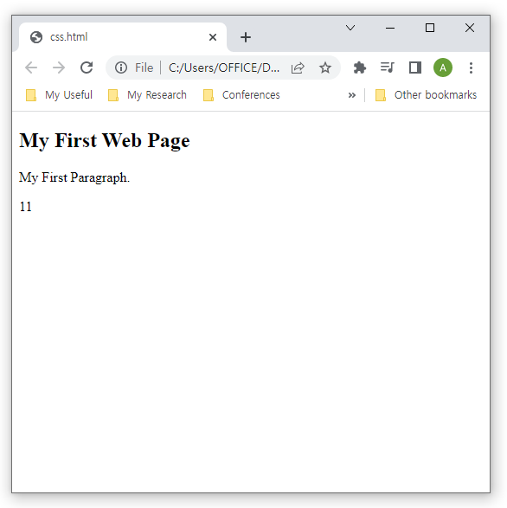
JavaScript Syntax
Using innerHTML
To access an HTML element, JavaScript can use the document.getElementById(id) method.
The id attribute defines the HTML element
The innerHTML property defines the HTML content
<!DOCTYPE html>
<html>
<body>
<h2>My First Web Page</h2>
<p>My First Paragraph.</p>
<p id="demo"></p>
<script>
document.getElementById("demo").innerHTML = 5 + 6;
</script>
</body>
</html>

Slide 16
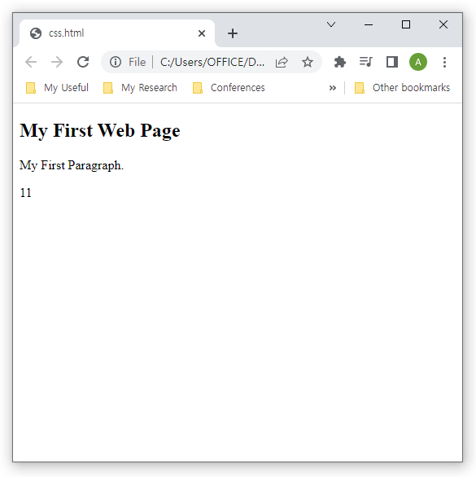
JavaScript Syntax
Using document.write()
For testing purposes, it is convenient to use document.write()
<!DOCTYPE html>
<html>
<body>
<h2>My First Web Page</h2>
<p>My First Paragraph.</p>
<script>
document.write(5 + 6);
</script>
</body>
</html>

Slide 17
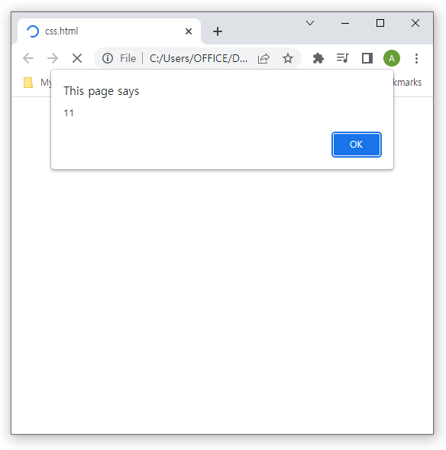
JavaScript Syntax
Using window.alert()
You can use an alert box to display data
<!DOCTYPE html>
<html>
<body>
<h2>My First Web Page</h2>
<p>My First Paragraph.</p>
<script>
window.alert(5 + 6);
</script>
</body>
</html>

Slide 18
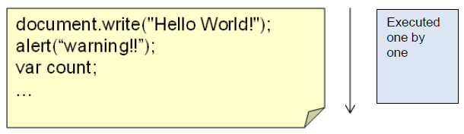
JavaScript Syntax
JavaScript Statement
JavaScript statements are commands to the web browser
JavaScript Comments
Single line comments start with //
Multi line comments start with /* and end with */

Slide 19
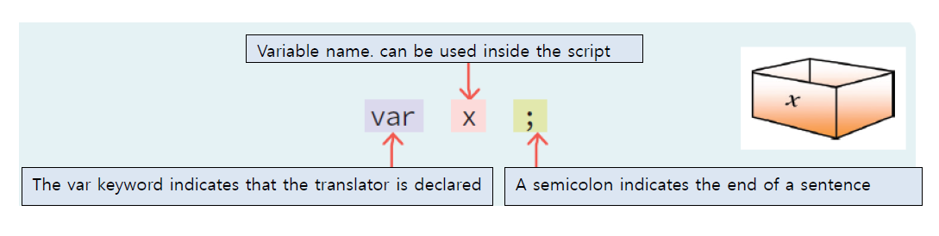
JavaScript Syntax
JavaScript Variables
Variable is a space for storing data
Declare variables using var keyword

Slide 20
JavaScript Syntax
JavaScript Variables
All JavaScript variables must be identified with unique names
Identifiers
The general rules for constructing names for variables (unique identifiers) are:
Names can contain letters, digits, underscores, and dollar signs
Names must begin with a letter
Names can also begin with $ and _
Names are case sensitive (y and Y are different variables)
Reserved words (like JavaScript keywords) cannot be used as names

Slide 21
JavaScript Syntax
JavaScript Variables
Reserved keywords

Slide 22
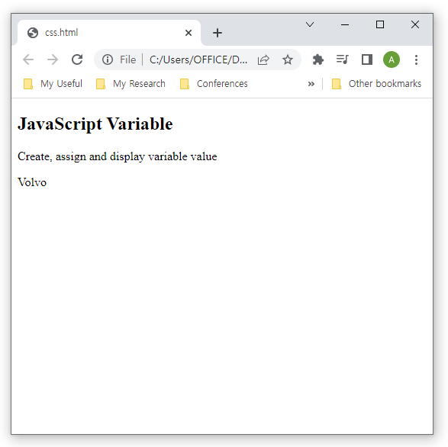
JavaScript Syntax
JavaScript Variables
Example
<!DOCTYPE html>
<html>
<body>
<h2>JavaScript Variable</h2>
<p>Create, assign and display variable value</p>
<p id="demo"></p>
<script>
var carName = "Volvo";
document.getElementById("demo").innerHTML
= carName;
</script>
</body>
</html>

Slide 23
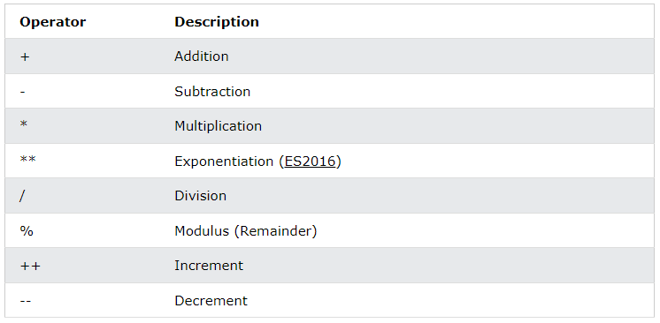
JavaScript Syntax
JavaScript Arithmetic
Arithmetic operators perform arithmetic on numbers

Slide 24
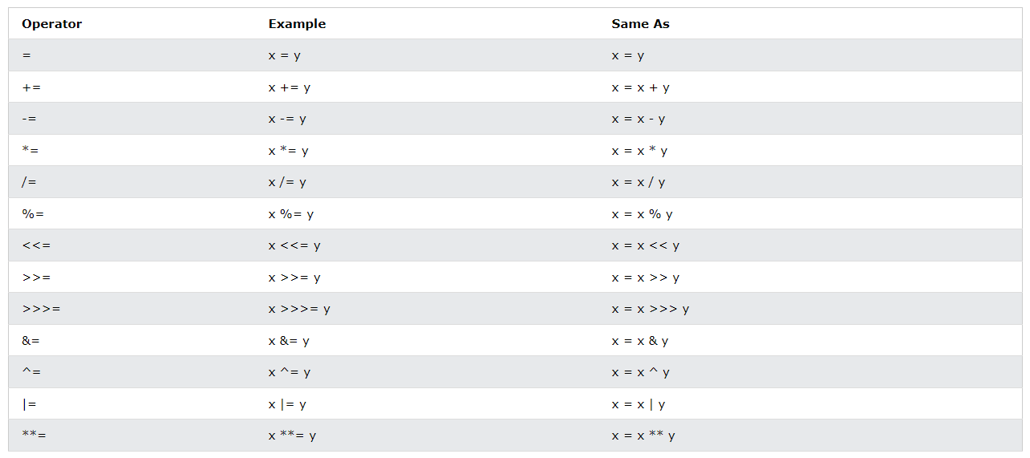
JavaScript Syntax
JavaScript Assignment Operators
Assignment operators assign values to JavaScript variables

Slide 25
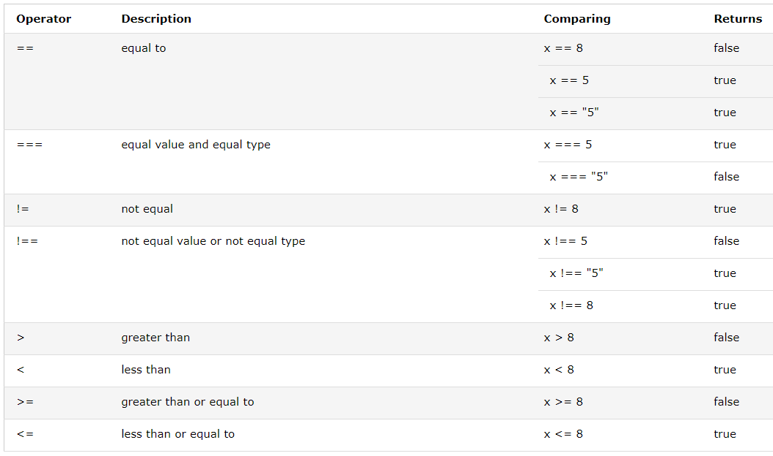
JavaScript Syntax
JavaScript Comparison Operators
Comparison operators are used in logical statements to determine equality or difference between variables or values

Slide 26
JavaScript Syntax
JavaScript Comparison Operators
==
Abstract Equality Comparison
"loose equality", "double equals"
Compare the identity of two operands even though, they are not of a similar type
===
Strict Equality Comparison
"strict equality", "triple equals“
Both the type and the value we are comparing have to be the same

Slide 27

JavaScript Syntax
JavaScript Comparison Operators
Difference between double equals and triple equals
<!DOCTYPE html>
<html>
<body>
<h2>JavaScript Comparsion</h2>
<p>The result of comparison:</p>
<p id="demo"></p>
<script>
var a = 10;
document.getElementById("demo").innerHTML
= (a == "10");
</script>
</body>
</html>

Slide 28

JavaScript Syntax
JavaScript Comparison Operators
Difference between double equals and triple equals
<!DOCTYPE html>
<html>
<body>
<h2>JavaScript Comparsion</h2>
<p>The result of comparison:</p>
<p id="demo"></p>
<script>
var a = 10;
document.getElementById("demo").innerHTML
= (a === "10");
</script>
</body>
</html>

Slide 29
JavaScript Syntax
JavaScript Data Types
JavaScript variables can hold different data types: numbers, strings, objects and more:
var length = 16; // Number
var lastName = "Johnson"; // String
var x = {firstName:"John", lastName:"Doe"}; // Object
When adding a number and a string, JavaScript will treat the number as a string
var x = 16 + "Volvo"; //Output: 16Volvo
var x = "Volvo" + 16; //Output: Volvo16
var x = 16 + 4 + "Volvo"; //Output: 20Volvo
var x = "Volvo" + 16 + 4; //Output: Volvo164

Slide 30

JavaScript Syntax
JavaScript Data Types
Example
var x = 5 + 5; //Output:
var y = "5" + 5; //Output:
Var z = "Hello" + 5; //Output:

Slide 31
JavaScript Syntax
JavaScript Data Types
JavaScript has dynamic types
The same variable can be used to hold different data types
Example
var x; // Now x is undefined
x = 5; // Now x is a Number
x = "John"; // Now x is a String

Slide 32
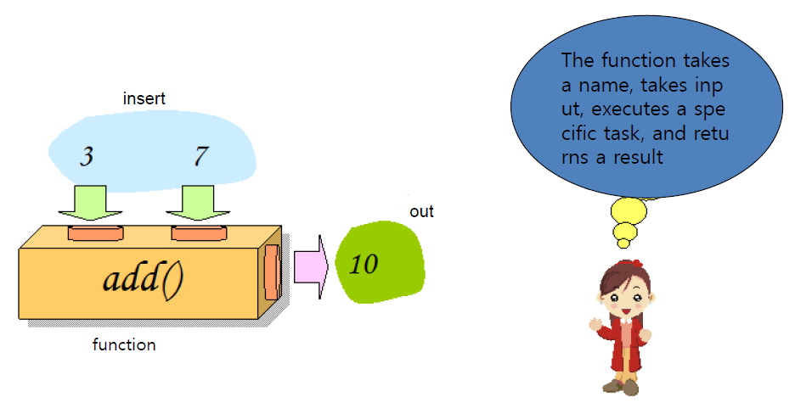
JavaScript Syntax
JavaScript Functions
Function is a black box that accepts input, performs a specific operation and returns a result

Slide 33
JavaScript Syntax
JavaScript Functions
Syntax
function name(parameter1, parameter2, parameter3) {
// code to be executed
}
Function Invocation
When it is invoked (called) from JavaScript code
Automatically (self invoked)
When an event occurs (when a user clicks a button)

Slide 34

JavaScript Syntax
When it is invoked from JavaScript code
Example
<!DOCTYPE html>
<html>
<body>
<h2>JavaScript Function</h2>
<p>Convert from Fahrenheit to Celsius</p>
<p id="demo"></p>
<script>
function toCelsius(f) {
return (5/9) * (f-32);
}
document.getElementById("demo").innerHTML =
toCelsius(77);
</script>
</body>
</html>

Slide 35
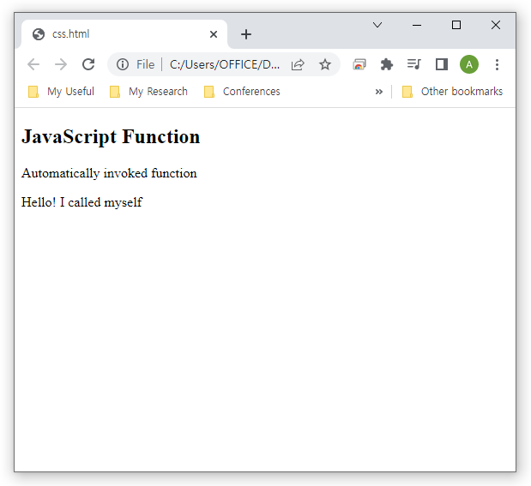
JavaScript Syntax
When it is invoked from JavaScript code
Function expressions will execute automatically if the expression is followed by ()
Example
<!DOCTYPE html>
<html>
<body>
<h2>JavaScript Function</h2>
<p>Automatically invoked function</p>
<p id="demo"></p>
<script>
(function () {
document.getElementById("demo").innerHTML
= "Hello! I called myself";
})();
</script>
</body>
</html>

Slide 36
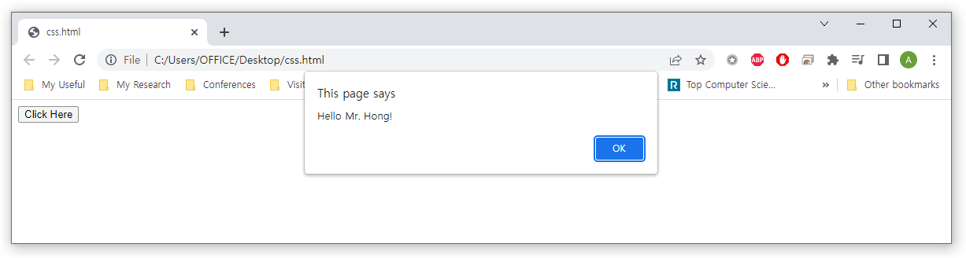
JavaScript Syntax
When an event occurs
Example
<script>
function greeting(title, name) {
alert("Hello" + " " + title + " " + name + "!");
}
</script>
<button onclick ="greeting('Mr.', 'Hong')">Click Here</button>

Slide 37
Summary and Discussions
JavaScript Features
Interpreted language
Dynamic typing
Functional programming (like C Language)
Object oriented programming (like C++ or Java)
JavaScript is a scripting language and it is not Java
It is easy to learn
Location of JavaScript
External JavaScript
Inner JavaScript
Inline JavaScript

Slide 38
Summary and Discussions
JavaScript Syntax
JavaScript Output
JavaScript Statement
JavaScript Comments
JavaScript Variable
JavaScript Operators
JavaScript Data Types
JavaScript Function

Slide 39
See you next time!
Questions?

